Slide 1
Image recognition
Lui Ho Yat, Wei Yidong

Slide 2
Topic
Ball recognition
Virus counting

Slide 3
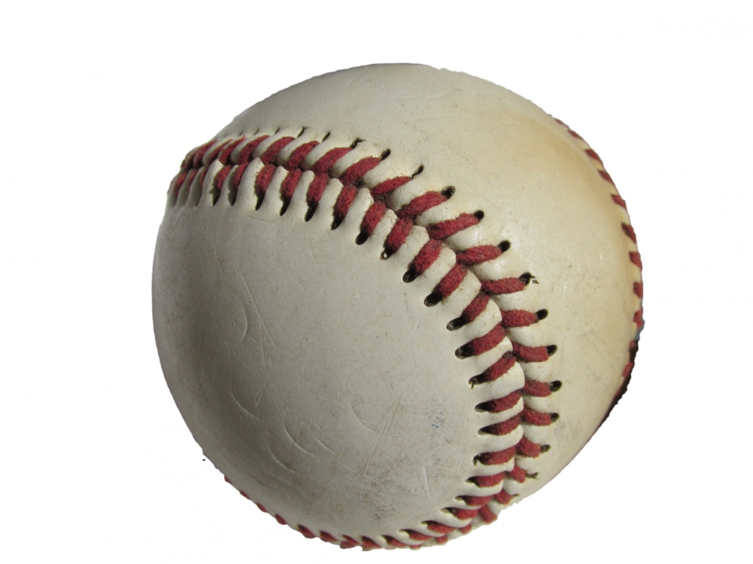
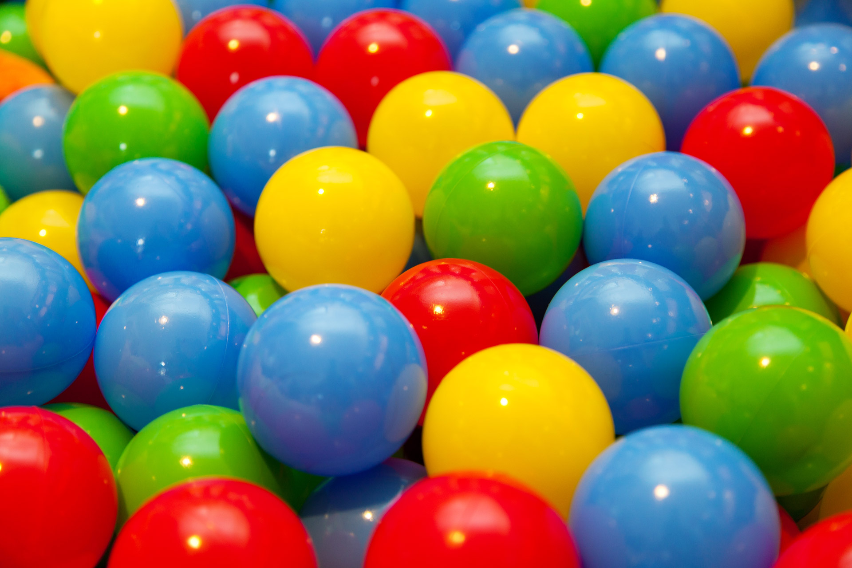
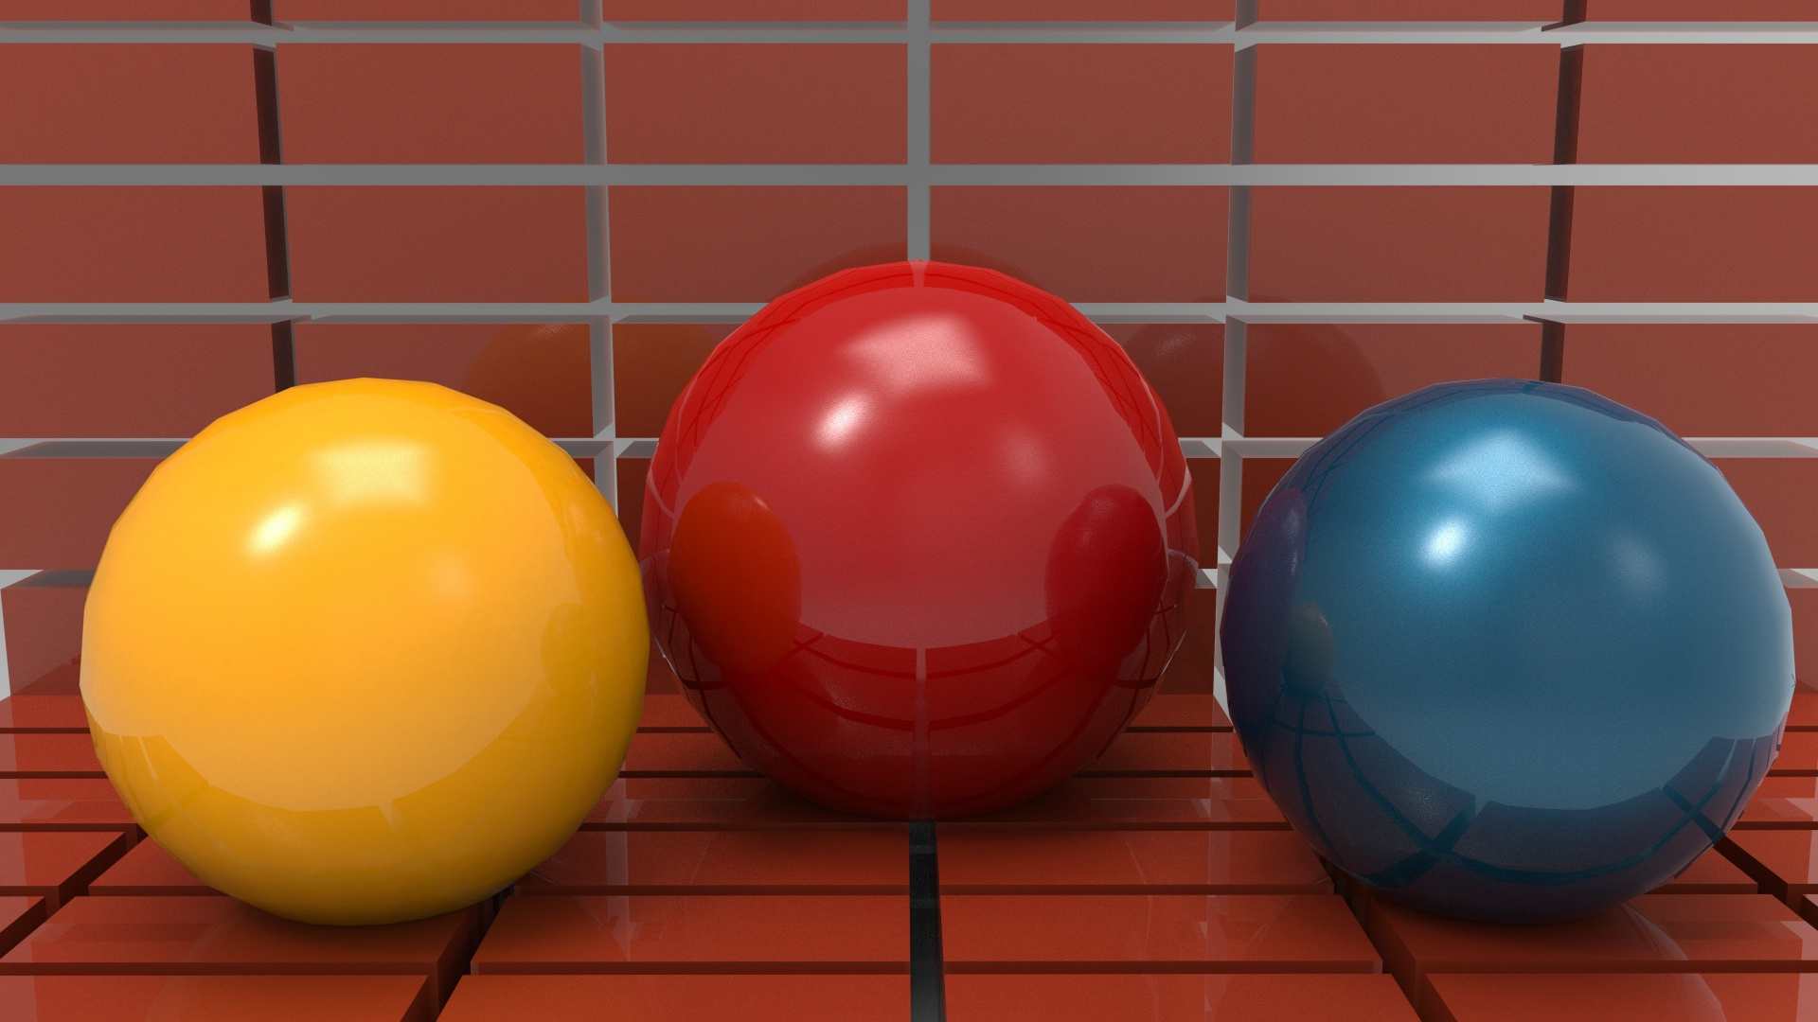
Part A: Ball recognition

Slide 4
Relevant Algorithms
Hough transform for circle detection
Canny edge detection
Similarity

Slide 5
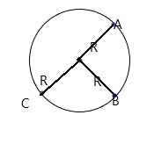
Hough transform for circle detection
Given a circle with 1.radius R,
2.three points A,B,C
How can we locate the circle?

Slide 6
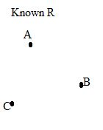
In Hough Transform:
With A, B, C as center,
draw a circle with radius R
The crossing point,
is the center of the
original circle

Slide 7
What if the radius is unknown?
What should we do?
R
R

Slide 8
implementation
Using a 3D matrix(Tensor),
X,Y axis corresponded to row and col in the original image
Z axis is the radius axis, it represent the value of the radius
We construct a cone for every point in the circle, and find the point in this 3D space that have most such
Constructed circle crossing
How to do this?
We using vote technique, whenever a circle constructed by point A with radius R,
we increasing the value by 1 in the corresponding location in the 3D matrix

Slide 9
OK, the full steps of our ball recognition Version 1.
Transform the desired image from RGB to grayscale
Downscale the image by preassigned ratio (10 – 20)
Using canny edge detection to find the edge in downscale space
Using Hough transform for circle detection in downscale space
Reverse the detected circle and radius to original space
Following a walk through example:

Slide 11
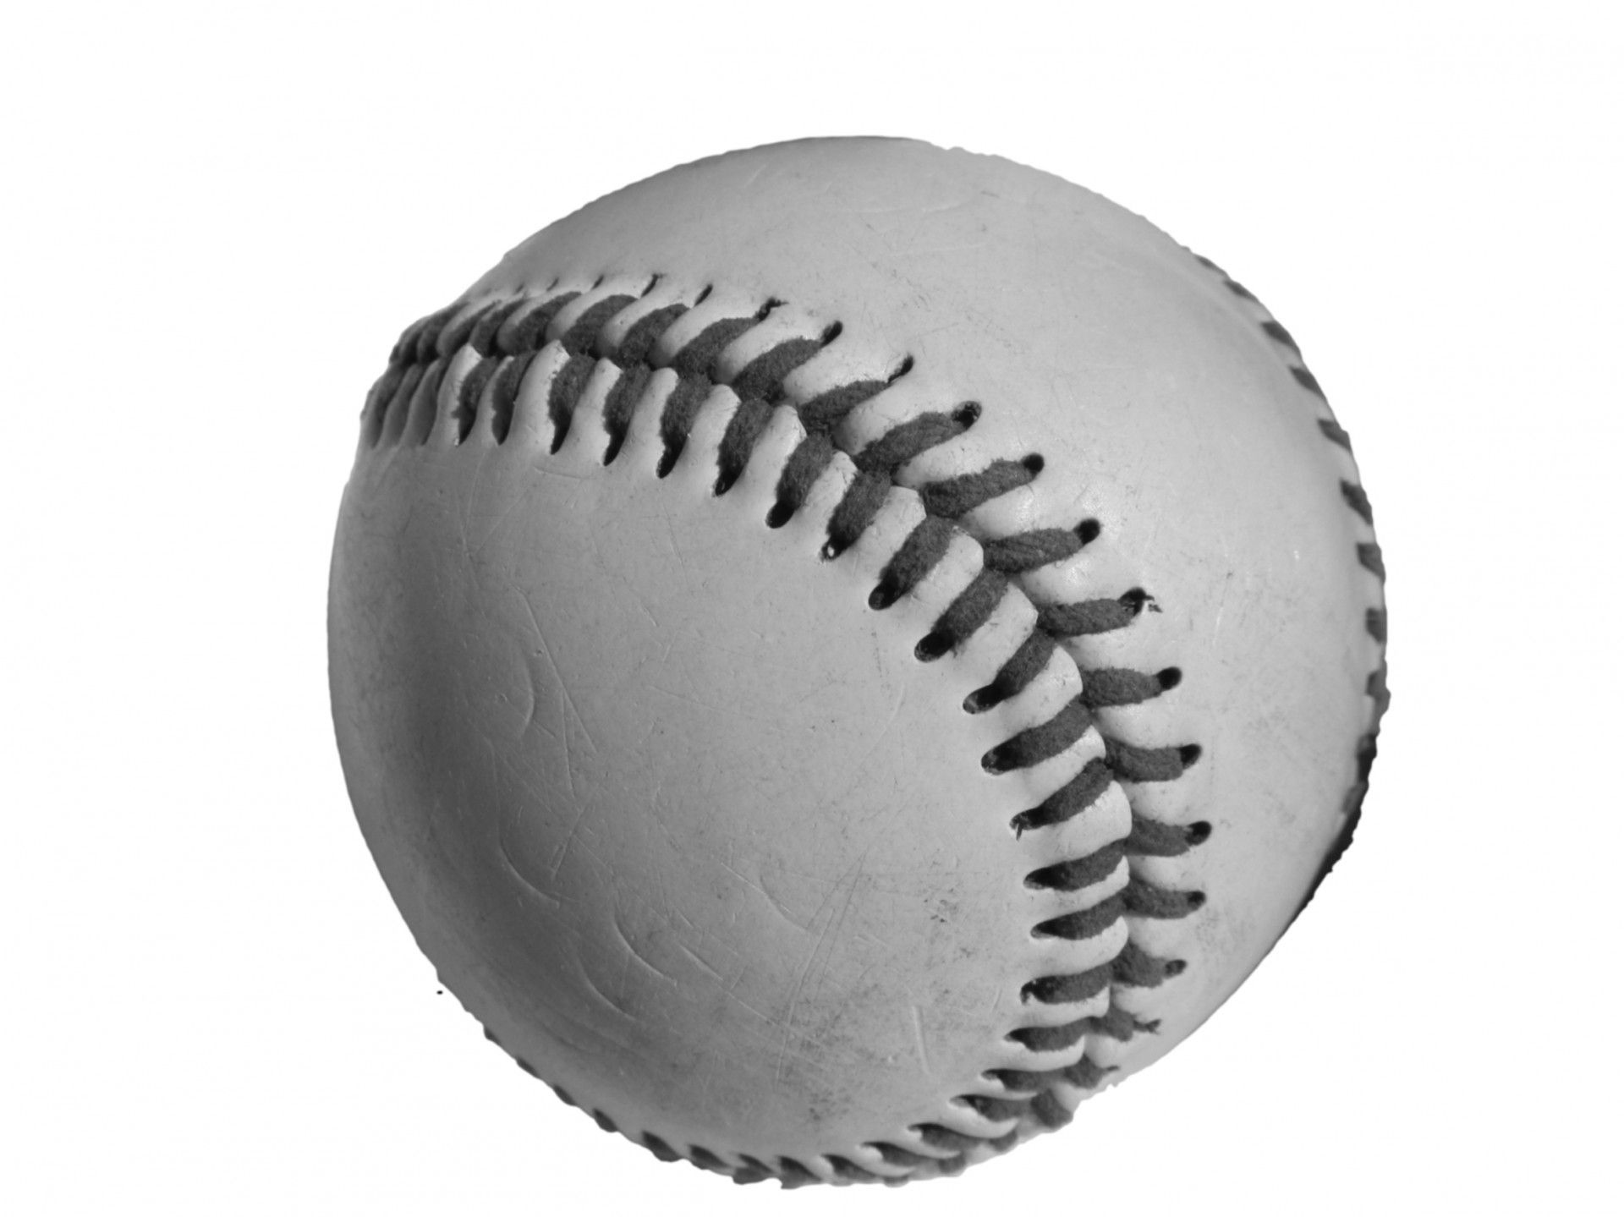

Slide 12


Slide 13

Too small,
No problem, I enlarge it manually for you

Slide 15
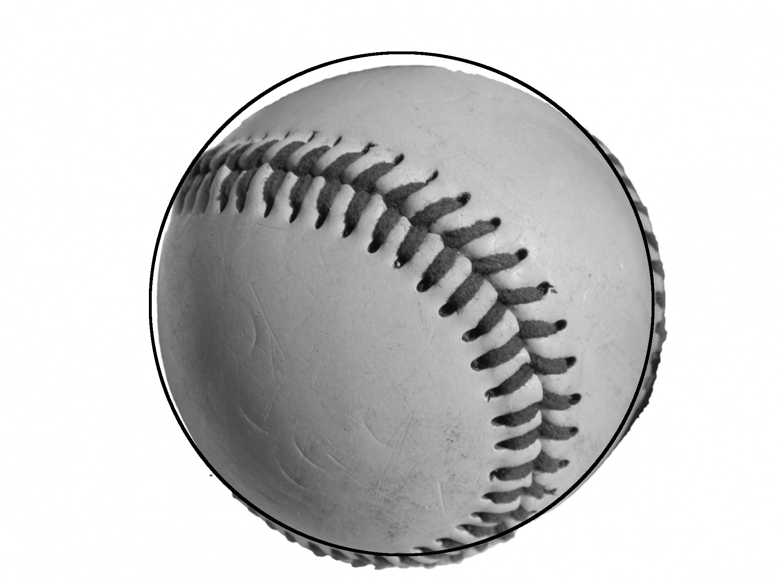

Slide 16
Cool, what about multi circle in the image
Forget to mention about, when we counting the crossing point in the 3D space, we just pick the point with most vote,
If we want to detect multiple ball in the image, we could set a threshold, for example: 0.8*max_vote

Slide 17

Another example:

Slide 18
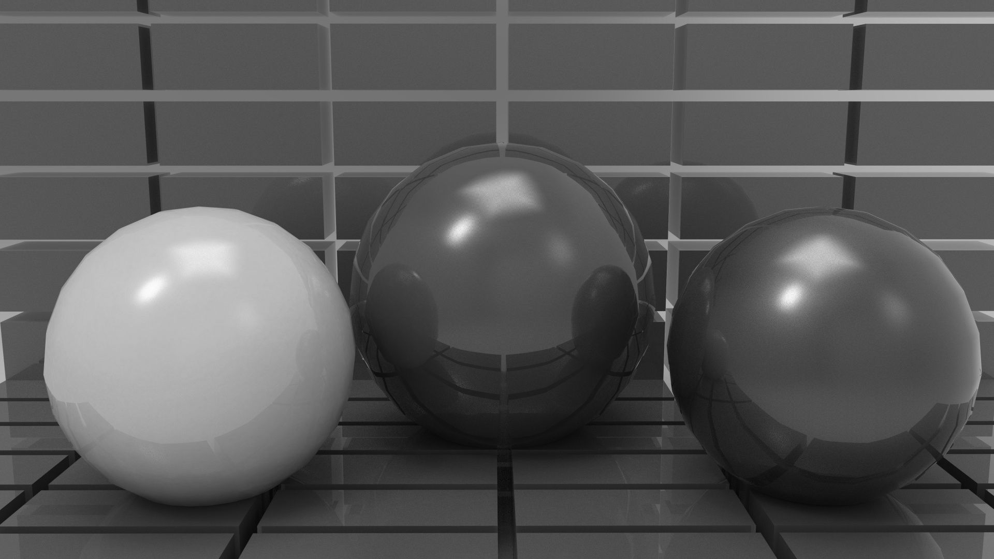

Slide 19
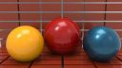


Slide 20
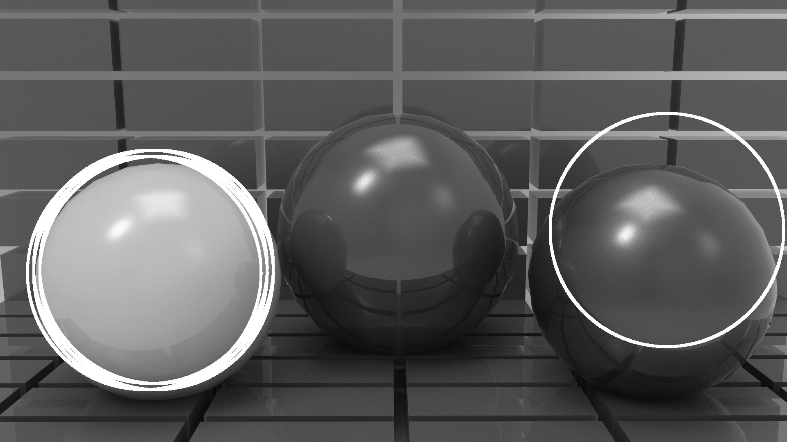

Slide 21
Problem
A ball get multiple detection
One ball get ignore and one ball get mis-located

Slide 22
Solution for problem 1:
Similarity detection:
The Hough transform return us a point with (x,y,z)
X,Y is the location in the downscale image,
Z is the radius of the circle
We calculate the similarity among candidates
If sim > threshold(example: 0.995 or 0.99),
remove one of them

Slide 23

Reason for problem 2:
Let’s take a look at the edge map detailly

Slide 24

Two ball actually get missing in the edge map

Slide 25
The color in the grayscale image is too close to background
Can we do better?
RGB Canny edge detection

Slide 26
Idea
Divide the image in 3 color channel: R, G, B
Calculate the gradient in each channel
Combining the gradient map by picking the maximum magnitude of each pixel among the 3 channel

Slide 27
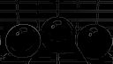

Slide 28



Slide 29
Next picture is the one applying RGB Canny edge detection and Hough Transform….

Slide 30
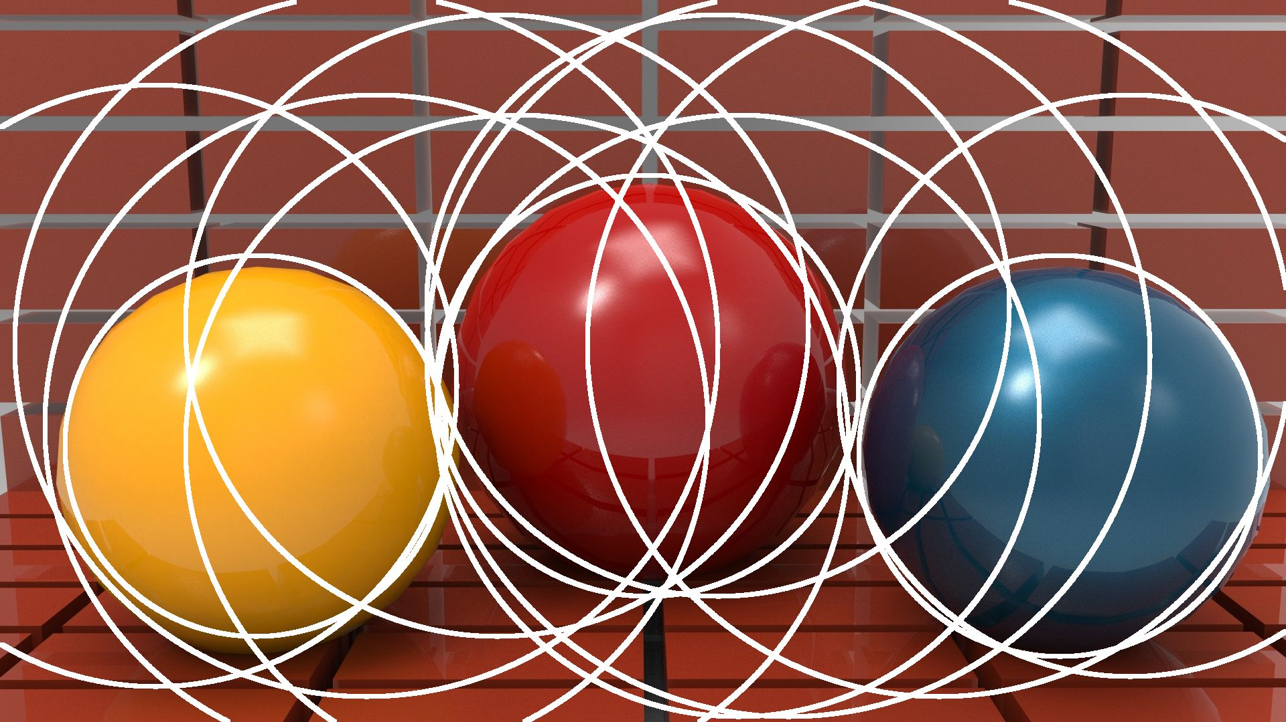

Slide 31
OOOPS…..
What’s the problem?
There is also some large circle get highlighted
…we know C = 2*R*Pi (circumference of circle)
Larger circle will have more chance to get voted by the point that does not belong to it

Slide 32
Honestly……
We did not fix this issue….
We asking the user to give a estimate of the circle size instead in our program.
Fine!
I will show the result with an estimation

Slide 33
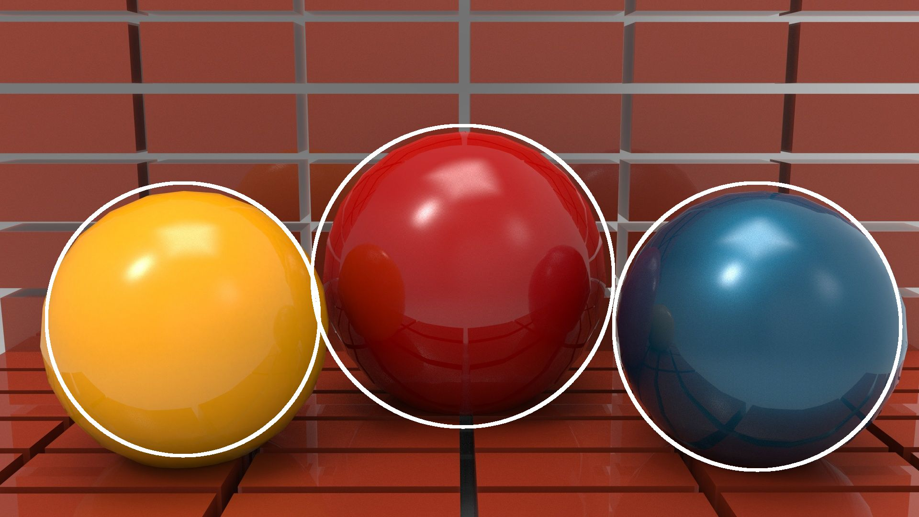

Slide 34
One more

Slide 35


Slide 36
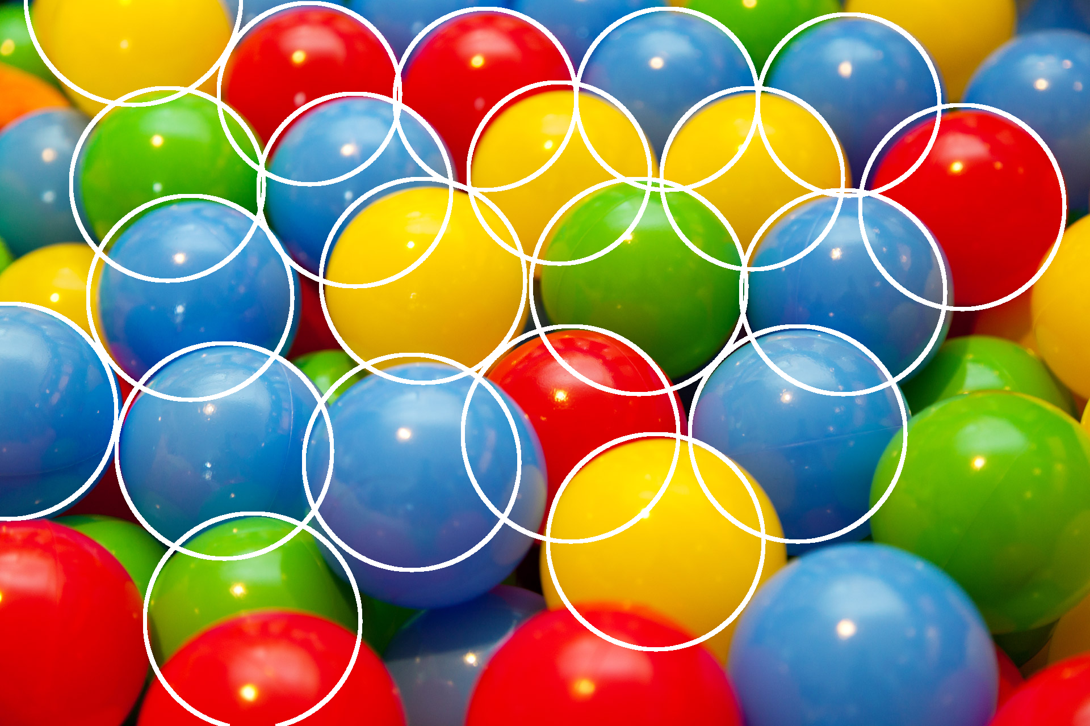

Slide 37
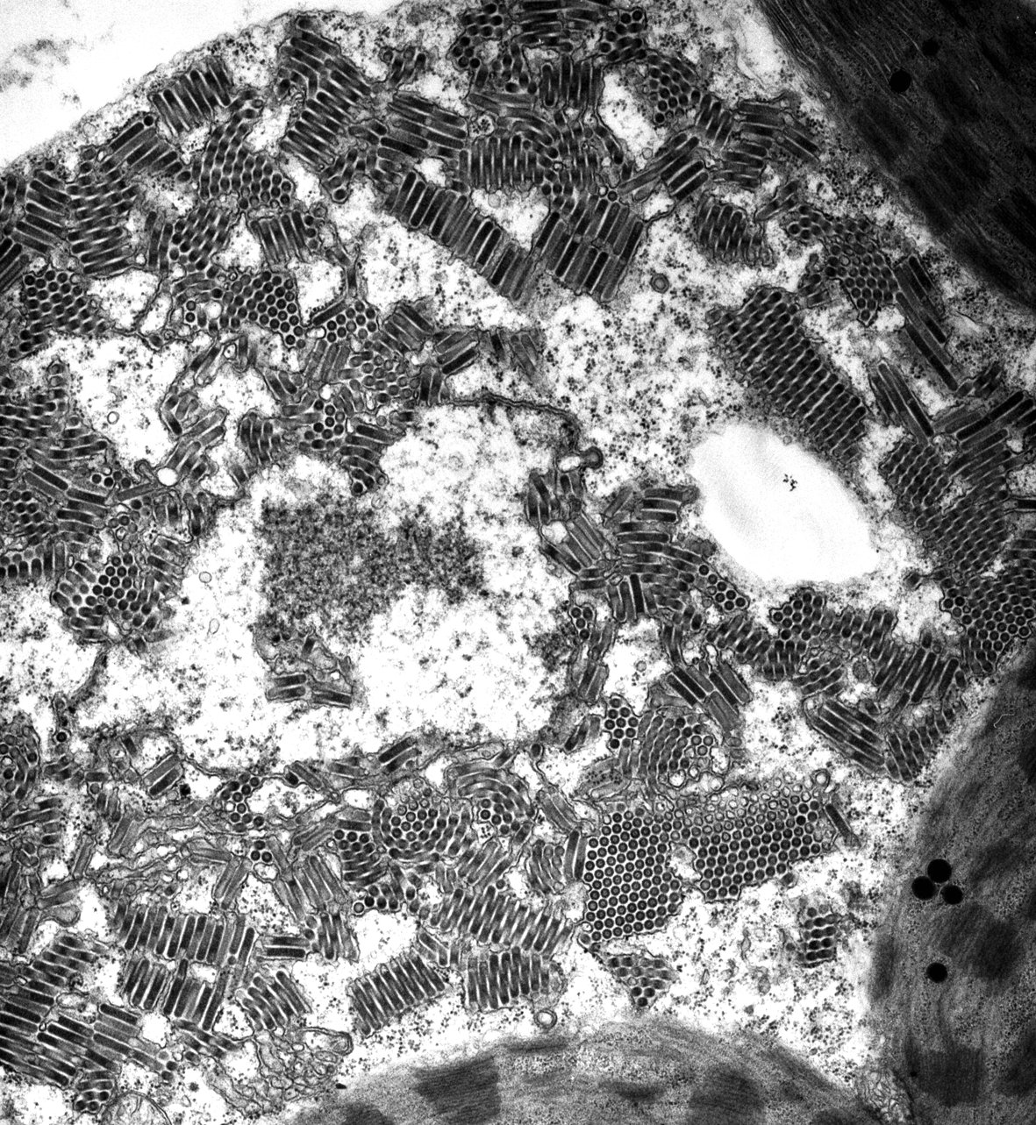
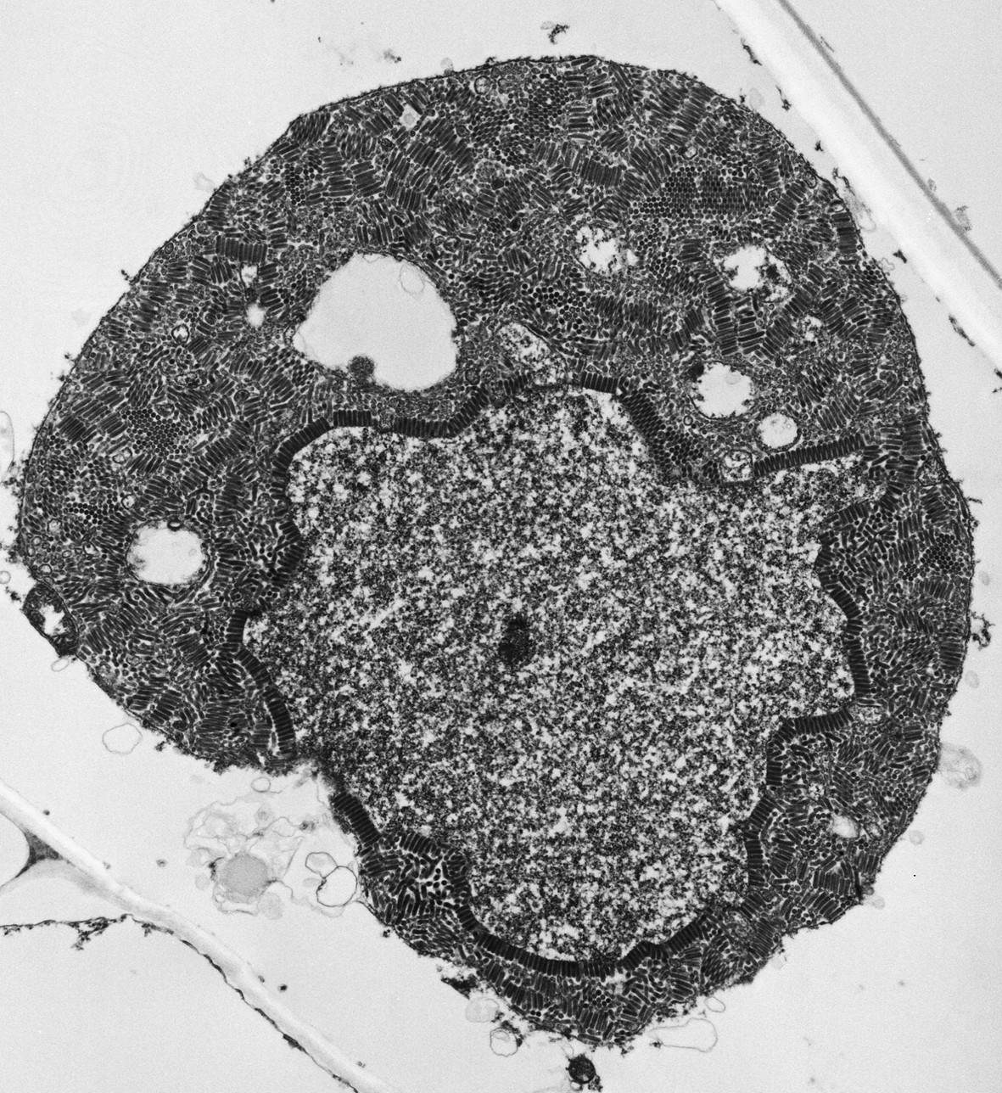
Part B: Virus detection and counting

Slide 38


Slide 39
preprocessing
We manually remove some unnecessary part in the image
Compare to counting that much virus, this is easy!!

Slide 40
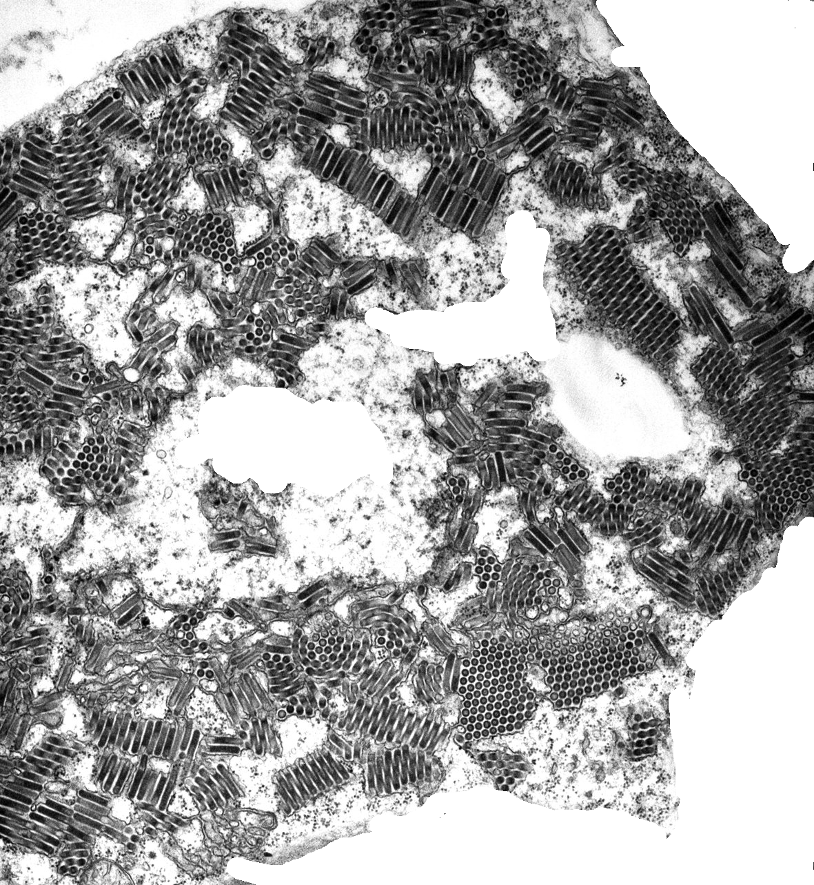

Slide 41
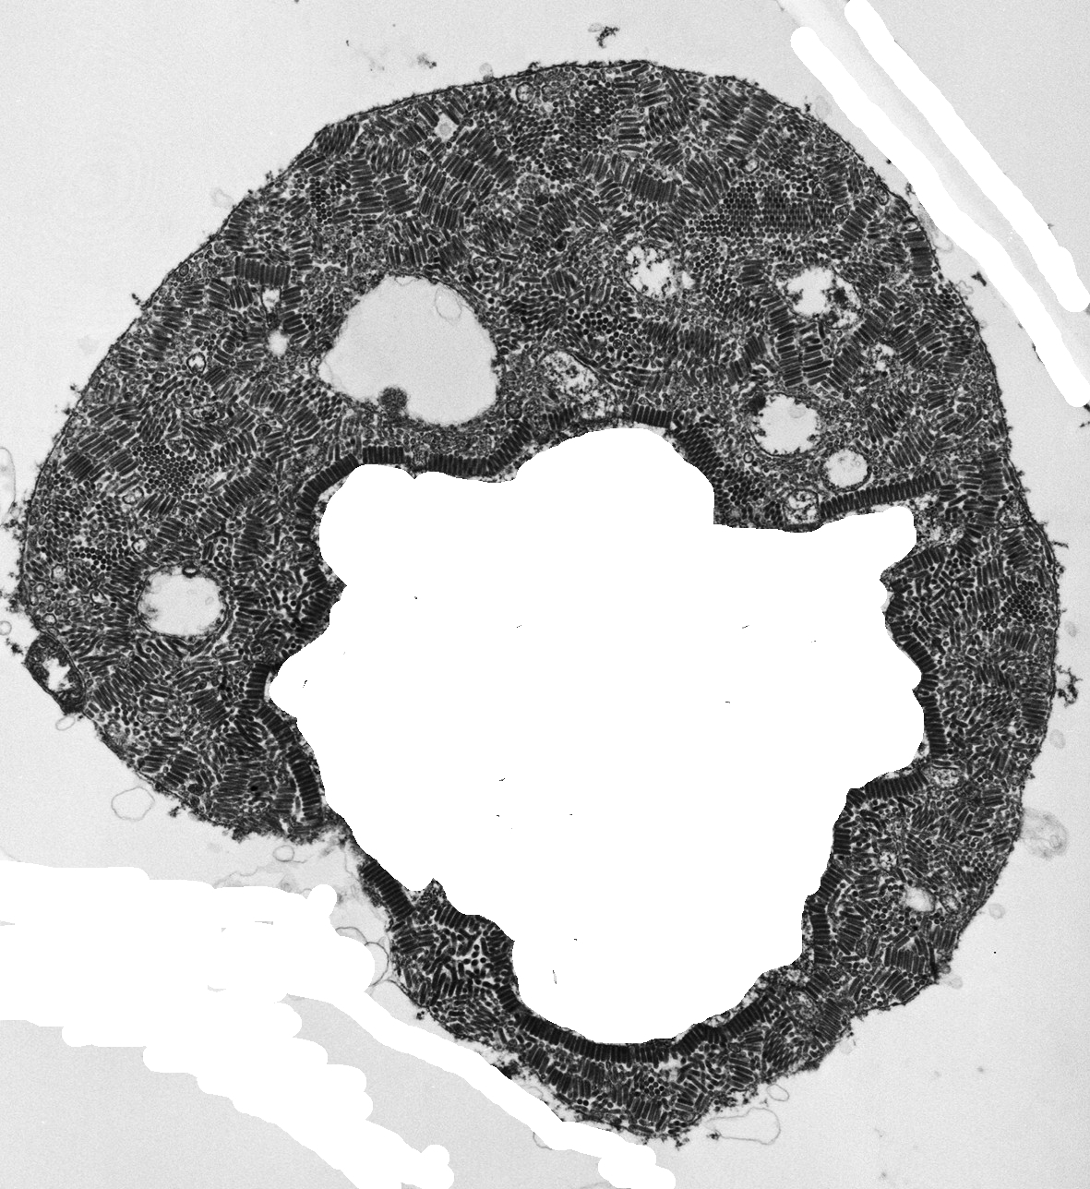

Slide 42
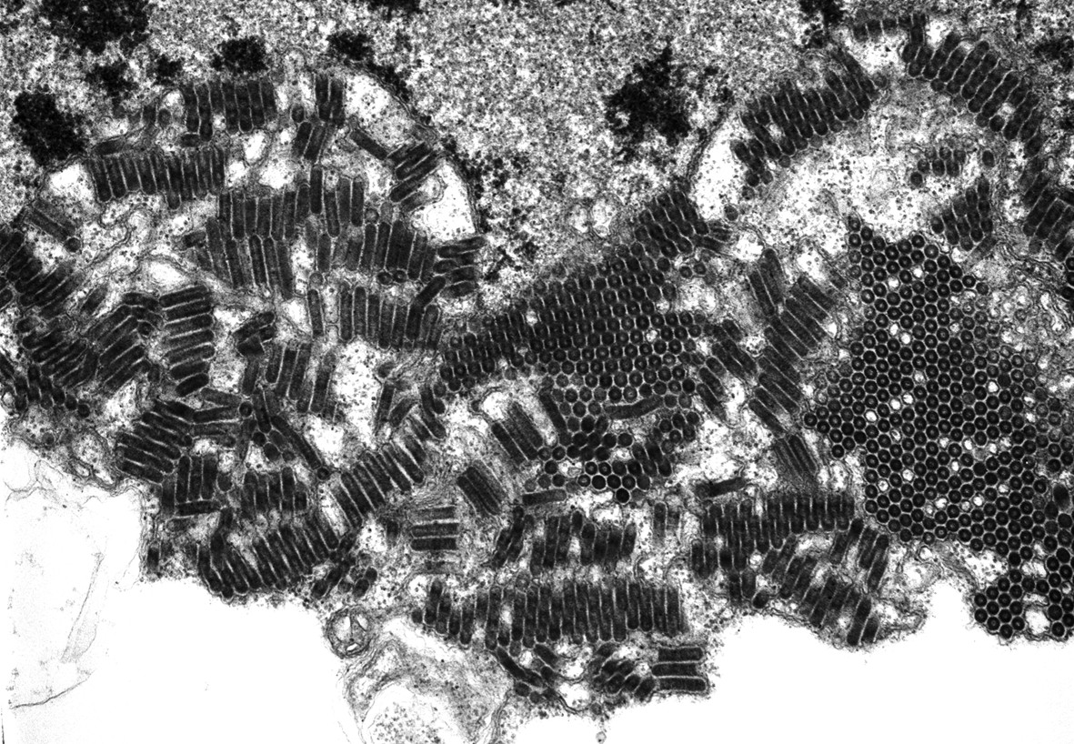

Slide 43
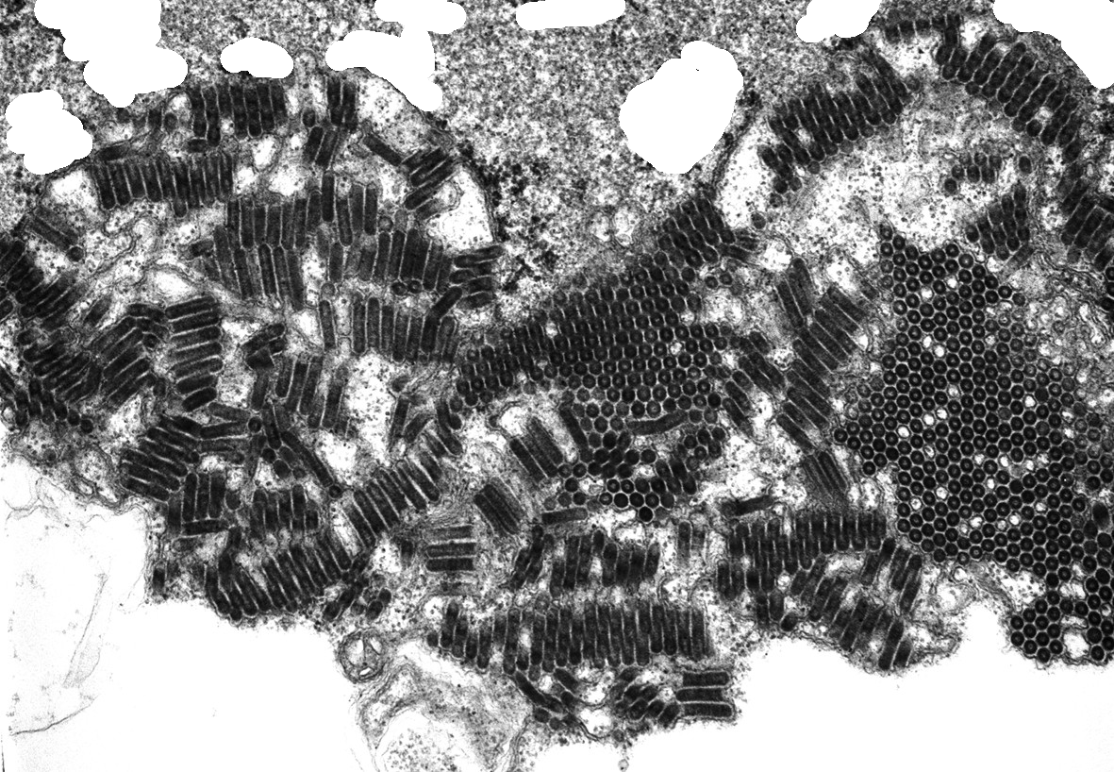

Slide 44
Relevant algorithm
Contrast Limit Adaptive Histogram Equalization(CLAHE)
Adaptive thresholding and binarization
Mathematical morphology operation
Contour map generation
Extrema locating(# of extrema is # of virus)
Watershed for segmentation(extra work!)

Slide 45
CLAHE
Increasing the contrast in the image: !locally!
It separate the image by grid and enhance the contrast in each sub image

Slide 46
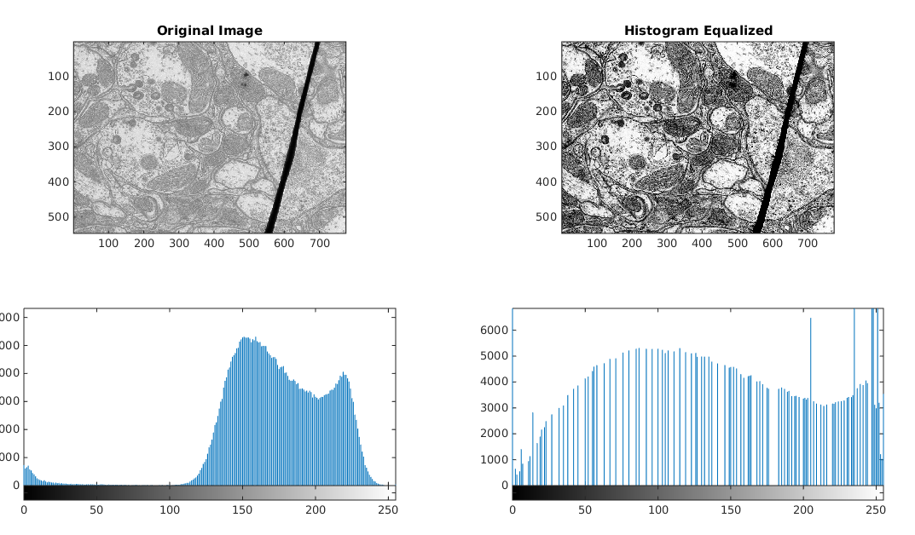
Image from:https://www.cse.iitb.ac.in/~arijitx/uploads/cs663/assignment1/part2/index.html

Slide 48
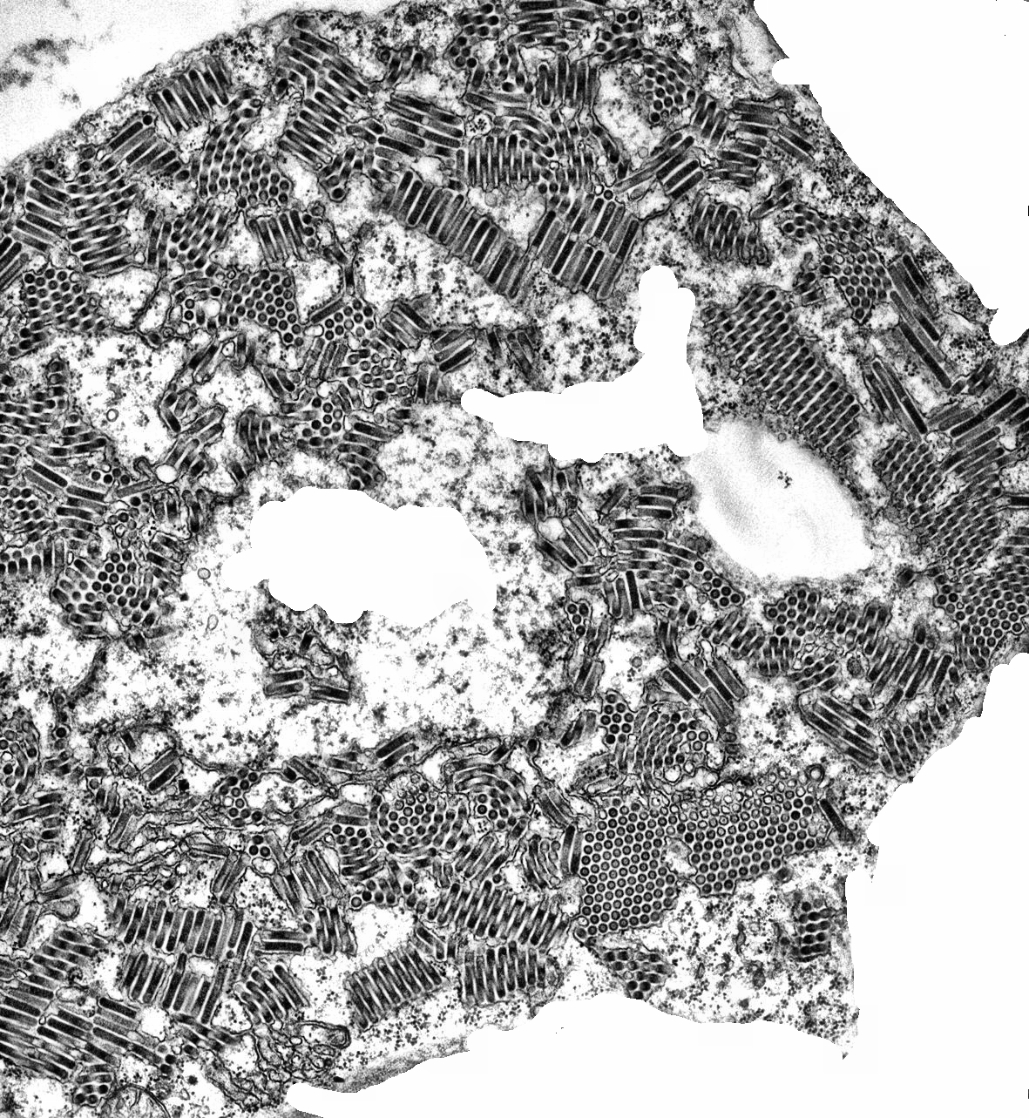

Slide 49
Adaptive thresholding (isoData) for binarization
Binarize the image into black and white(one refer to object, one refer to background )
The threshold is choosing adaptively and iteratively
Step 1: random pick a value ‘t’ as threshold
Step 2: calculate average intensity of pixels < t: T(Under) and pixels > t: T(above)
Step 3: if t != (T(under)+T(above))/2, t = (T(under)+T(above))/2, go back to step 2, else, done

Slide 50
origin

Slide 51
clahe

Slide 52
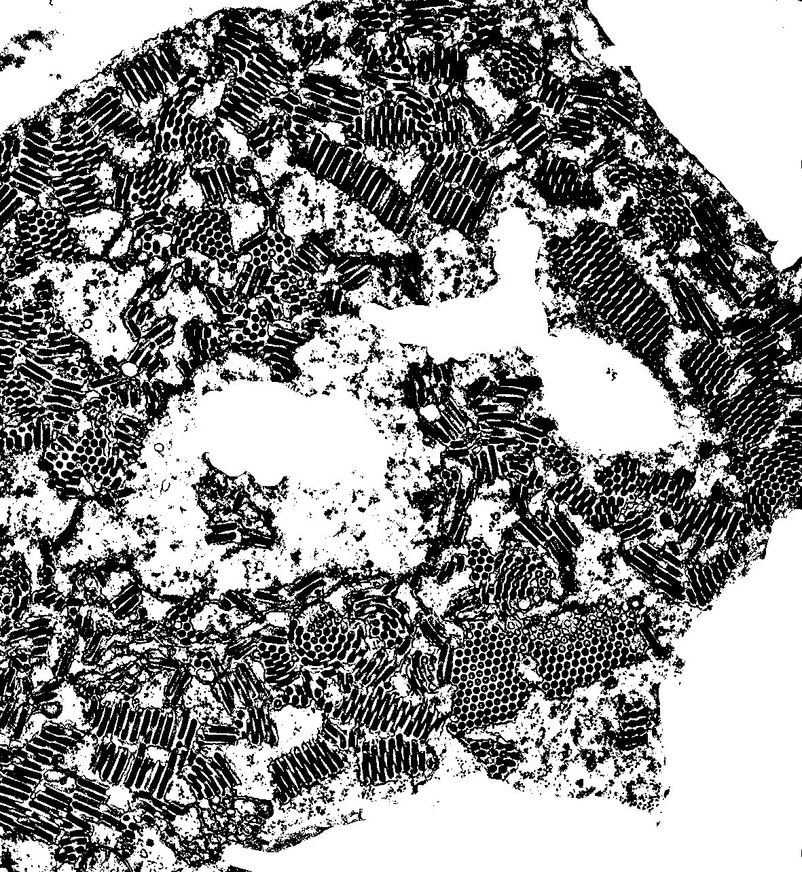
After adaptive thresholding
and make binary

Slide 53
Mathematical morphology operation
1. erosion: https://www.youtube.com/watch?v=fmyE7DiaIYQ
2. dilation: https://www.youtube.com/watch?v=xO3ED27rMHs
3. closing: dilation followed by erosion
4. opening: erosion followed by dilation
Here, closing could used to remove small black elements, and opening could used to remove small white element in binary image

Slide 54
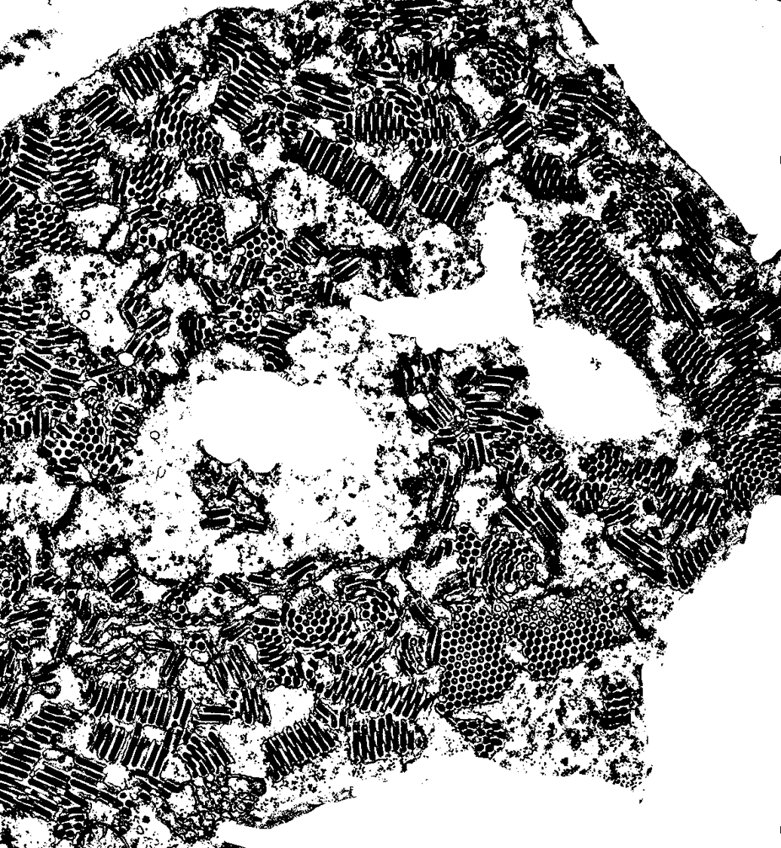
In our project, we using closing to remove noise at the binary image

Slide 55
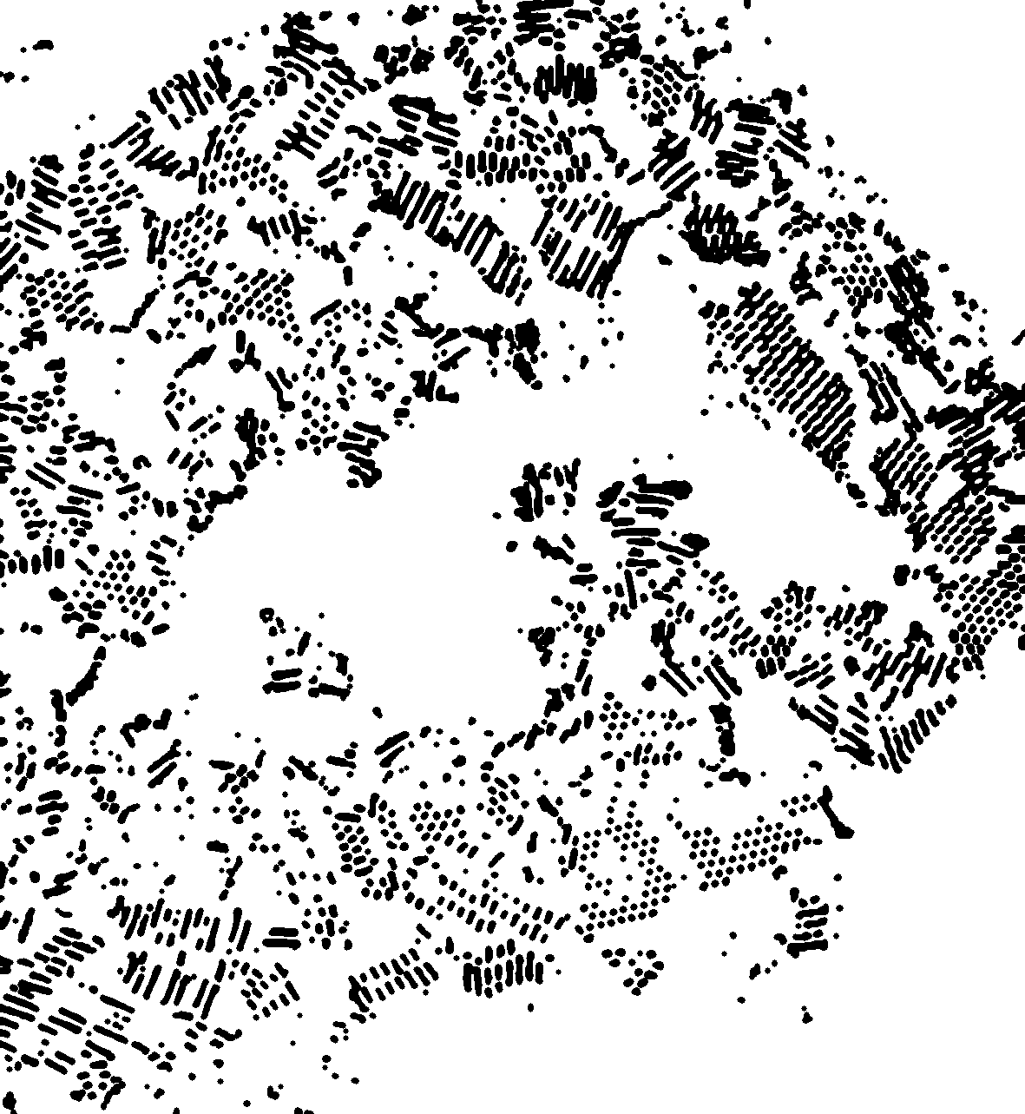

Result of closing by 3 pixel radius disk kernel
3*3 disk kernel

Slide 56
Walk through What we do is similar(but not equal) to do 3 time dilation of disk kernel 1 and 3 time erosion of disk kernel 3, we will use it as an walk through example

Slide 57
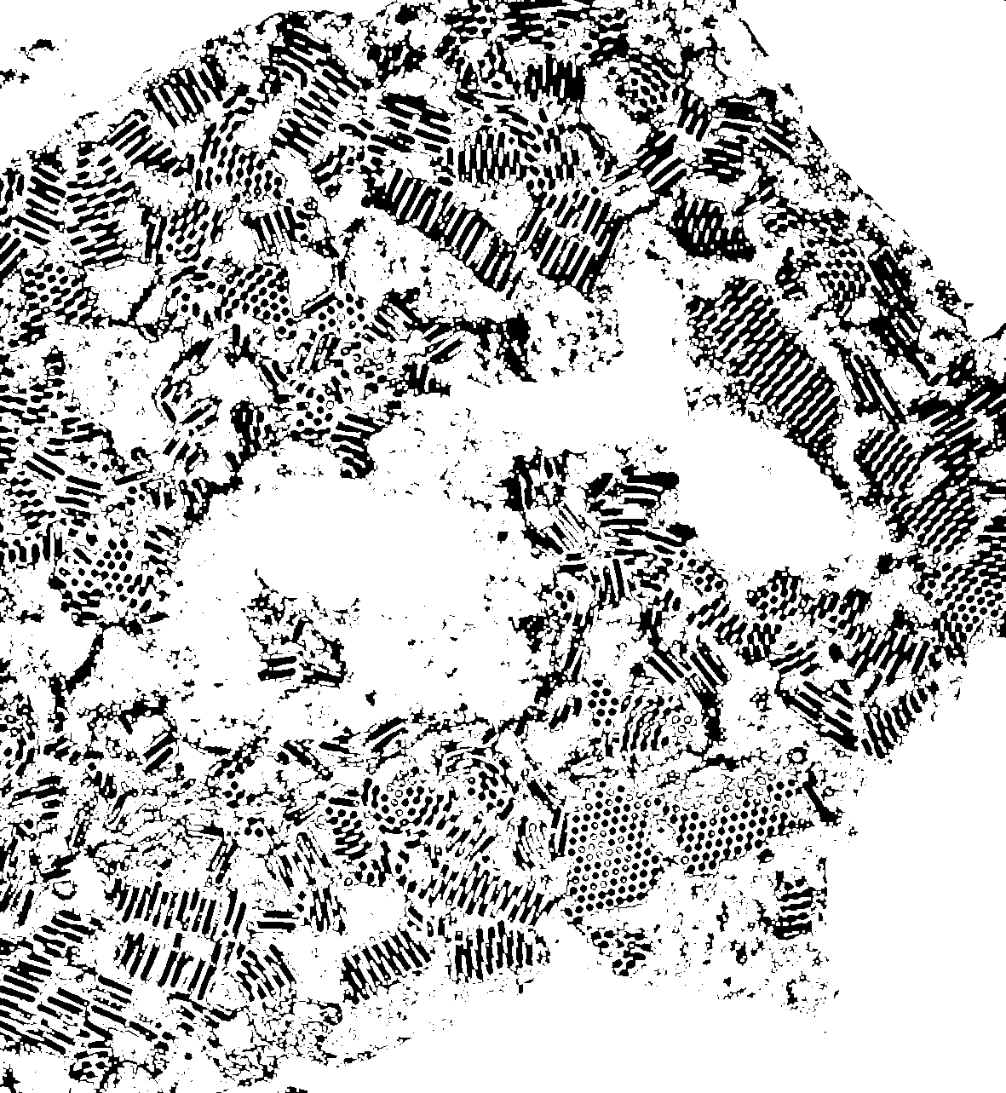
First dilation

Slide 58
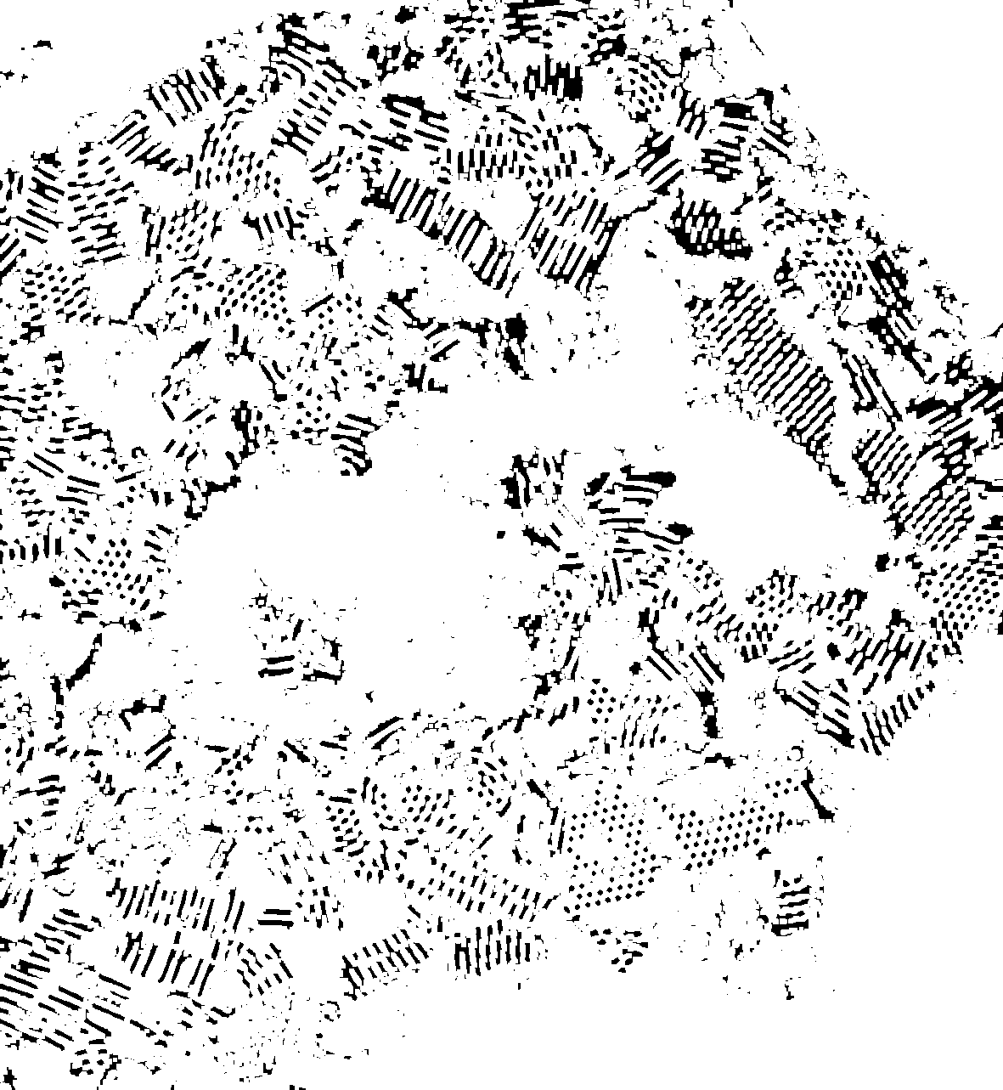
Second dilation

Slide 59
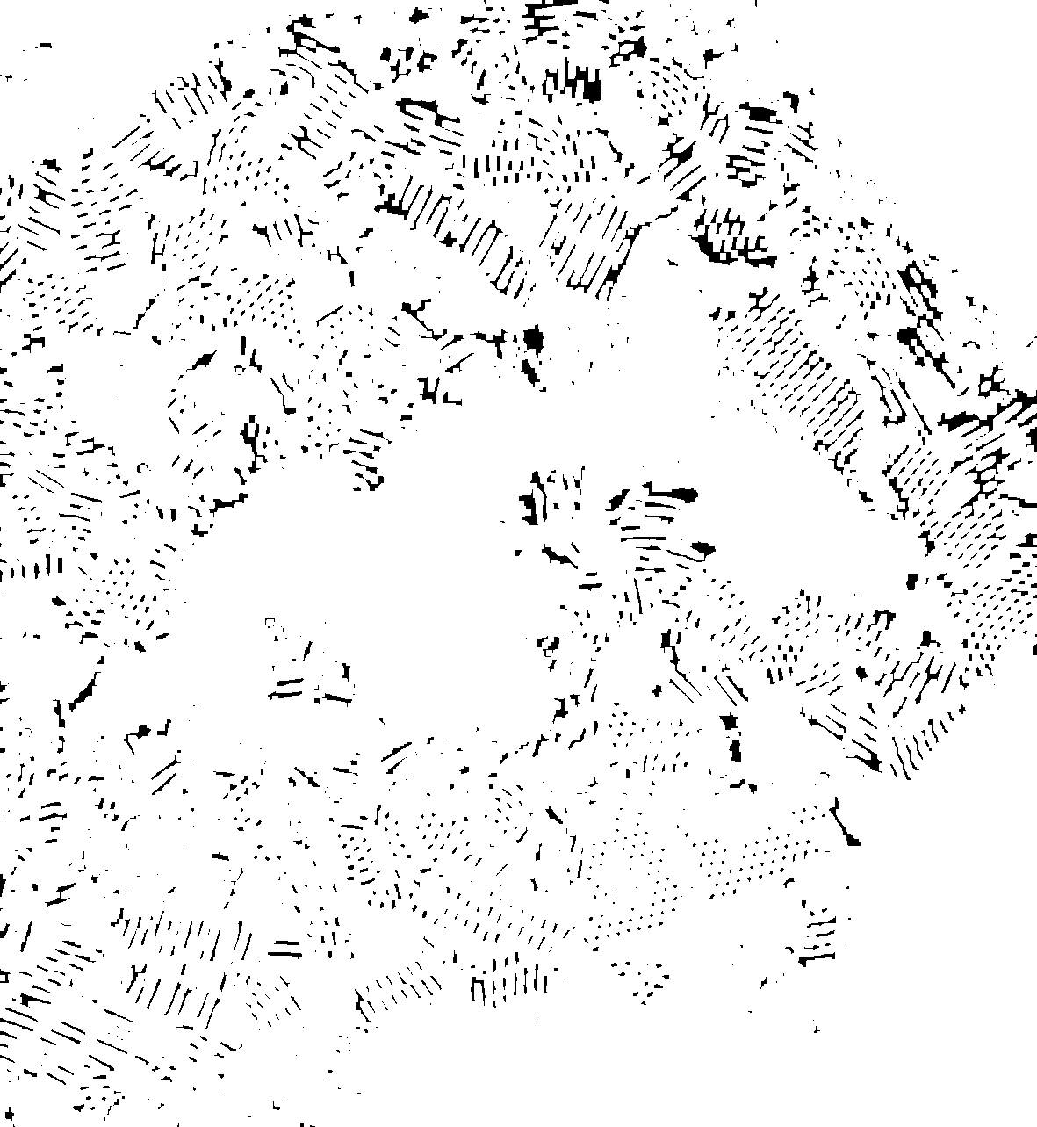
Third dilation

Slide 60

First erosion

Slide 61

Second erosion

Slide 62

Third erosion

Slide 63
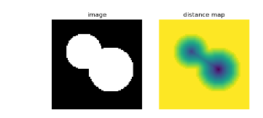
Contour map
Find the distance of each pixel in object(0) to the background(1)
Using Euclidean distance, keep in float format
To visualization, we will covert it to int then visualize

Slide 64
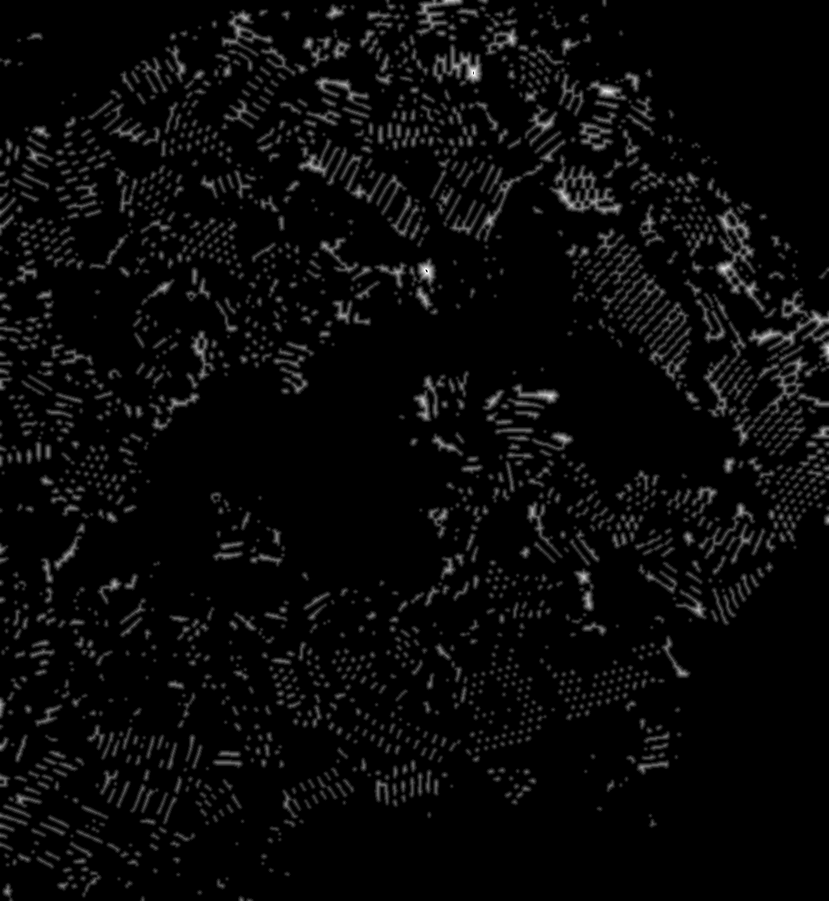
Distance map of our image

Slide 65

Find the extrema in the contour map
The extrema are the pixels that is furthest from the background comparing to its neighborhood

Slide 66
Method we use to find the extrema
For this image:
Based on the contour map, we find the pixel that is largest in the window with size 2*3-1=5, that is 5*5 window.
Why 5? We using disk kernel with radius 3 for closing, then the object left in the image is at least with diameter 3*2 + 1 = 7, and the distance between two objects is at least 6, using 5 could help us to avoid combining different object together.
Maybe…not good for virus with rod shape…that is the limitation of our method

Slide 67
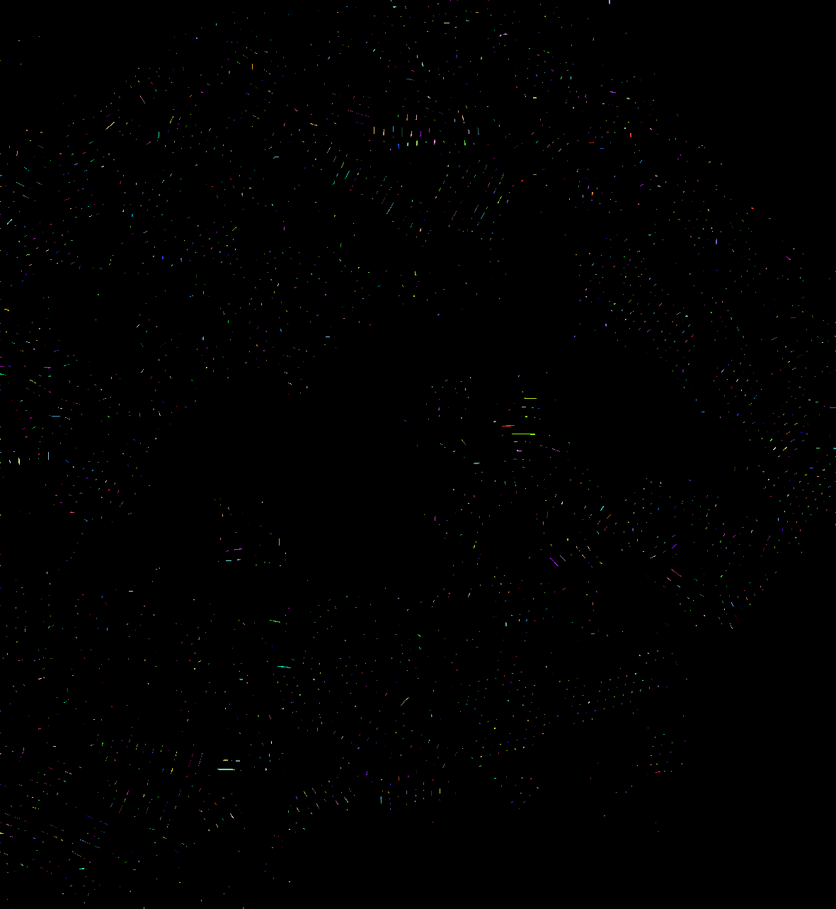
extrema show
We Count 2677
Actual: 2300~2400

Slide 68
Yeah, done! The number of the extrema is the number of virus we detect
However, we did some extra
work to segmentation the virus

Slide 69
Watershed for virus segmentation
Step 0: convert the contour map to integer
Step 1: build a list of queue, the ith queue will contain the pixel with distance i to the background
Step 2: add every extrema to the queue they correspond to(by the distance of extrema to the background)
Step 3: pop the queue in highest level(the queue of the pixels that are furthest from the background), find this pixels’ non-background neighborhood pixels, mark them as the same color of the popped pixel, and add them to the corresponding queue(by their distance to background)

Slide 70
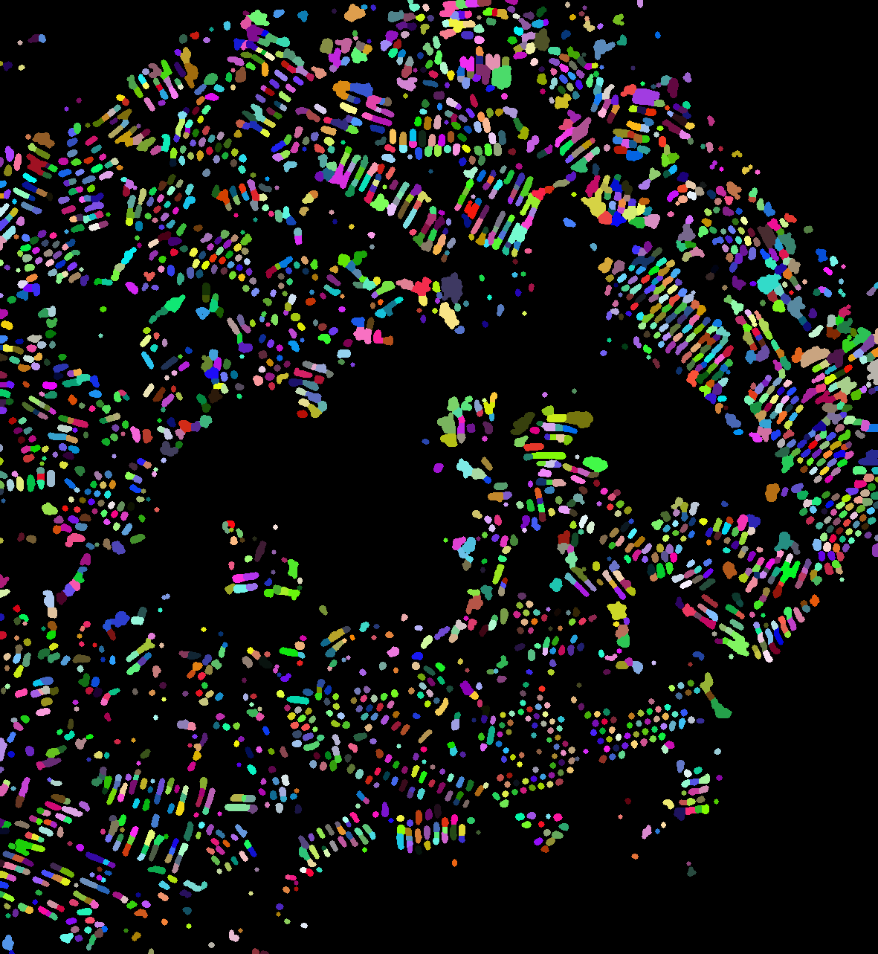
Result of watershed

Slide 71
To sum up:

Slide 80
One more example:

Slide 82
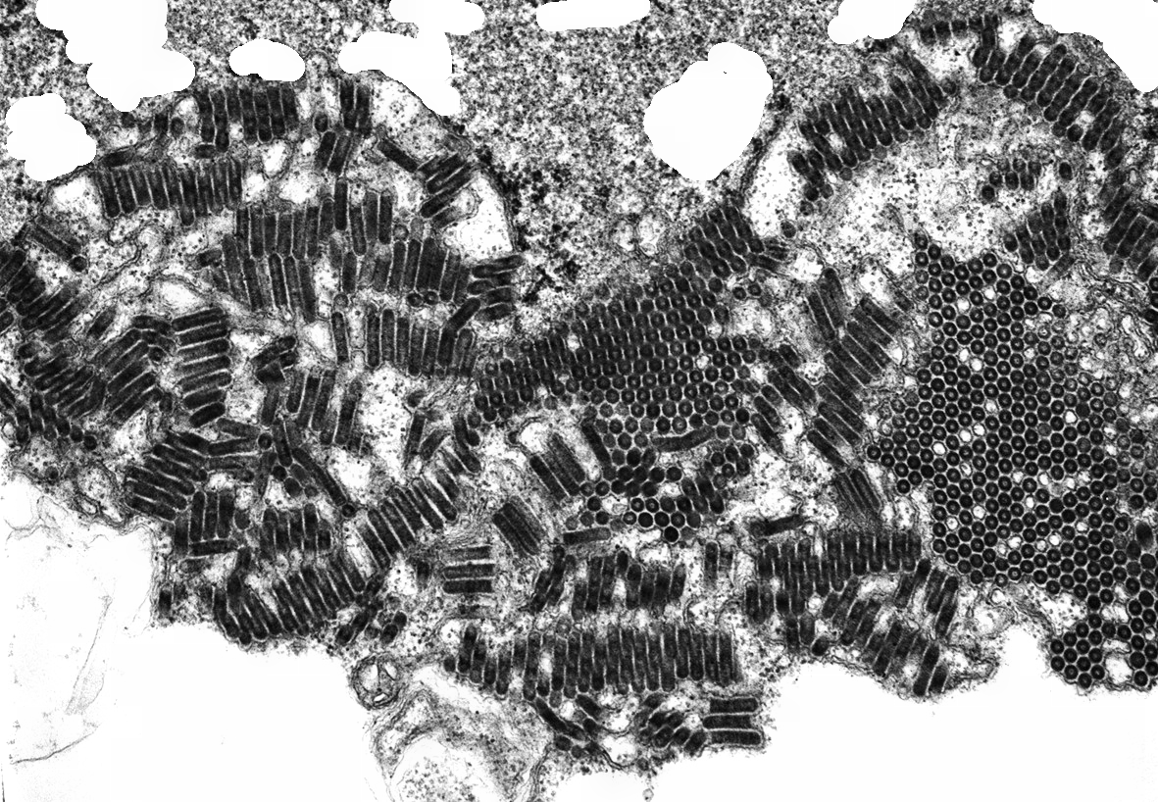

Slide 83
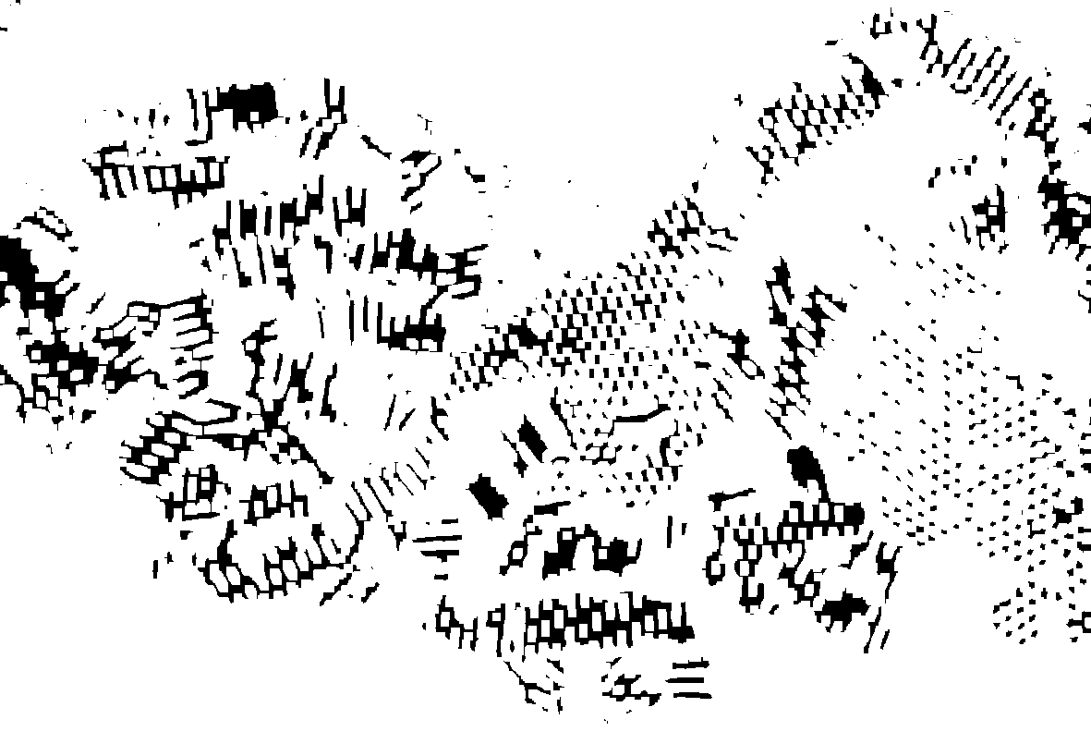

Slide 84
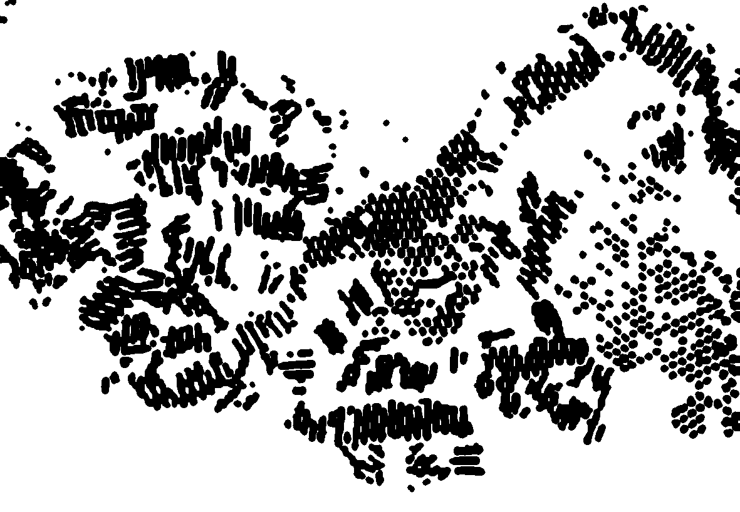

Slide 85


Slide 86
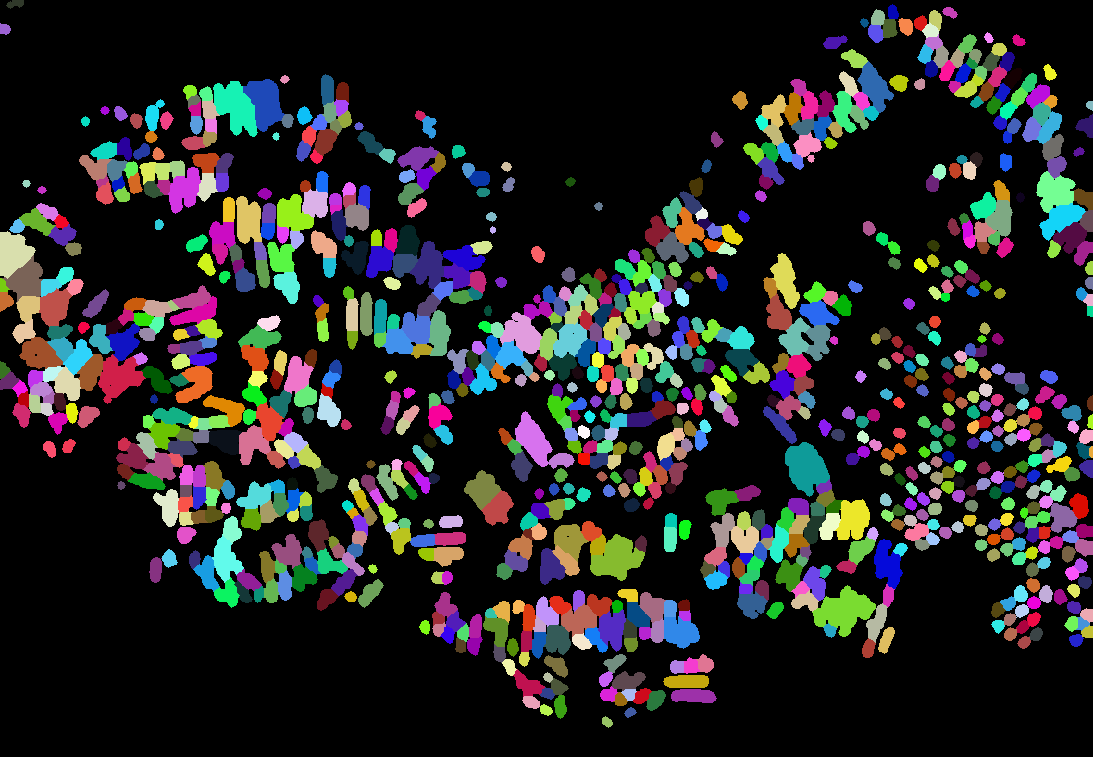

Slide 87
Last example:

Slide 89
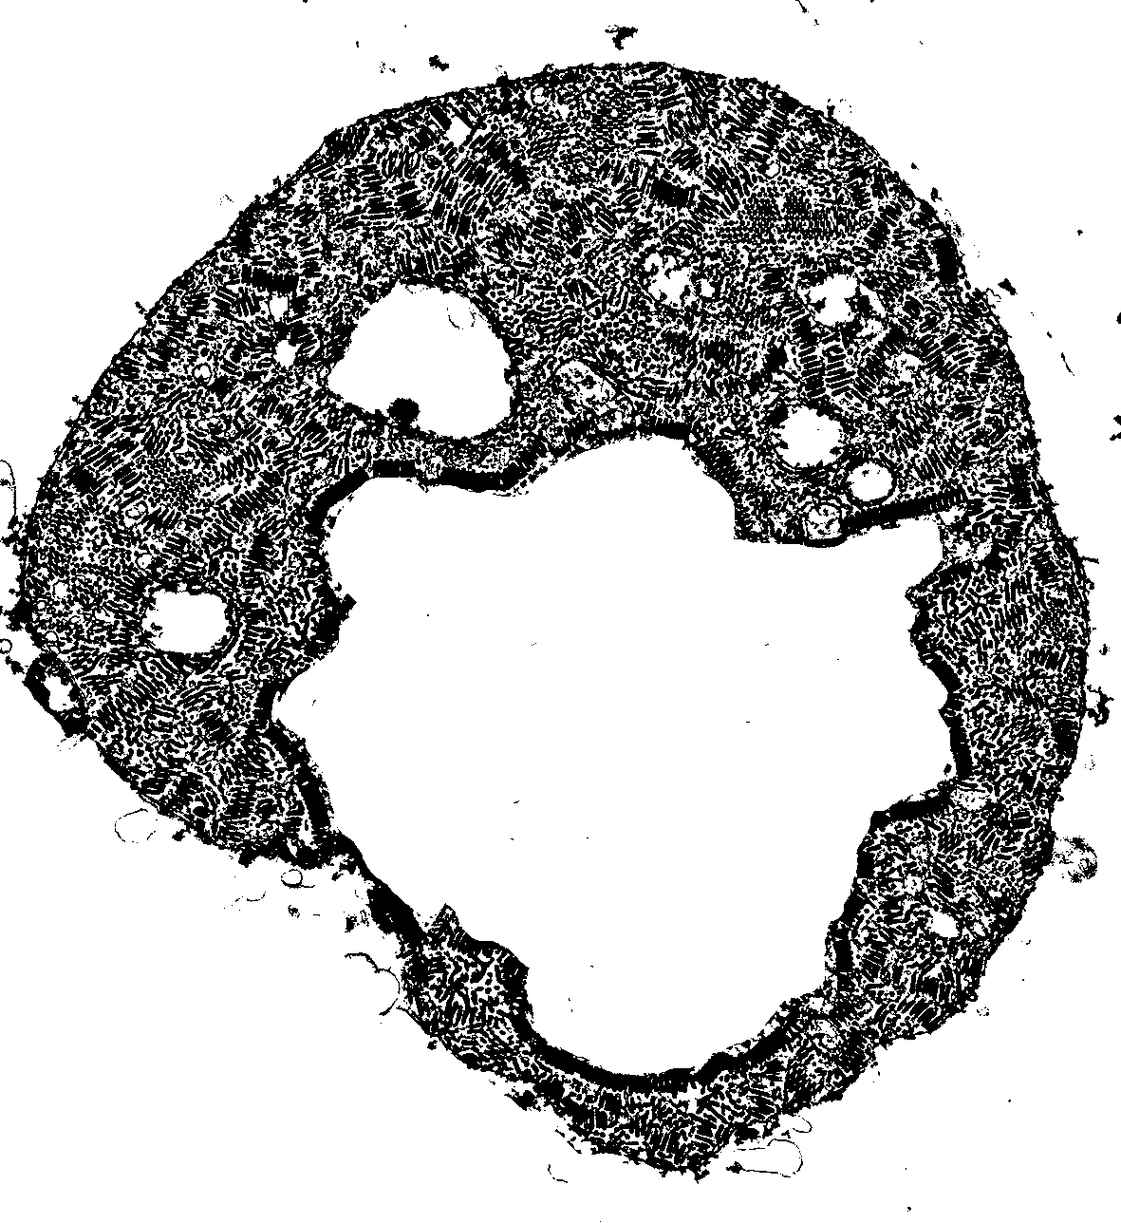

Slide 90
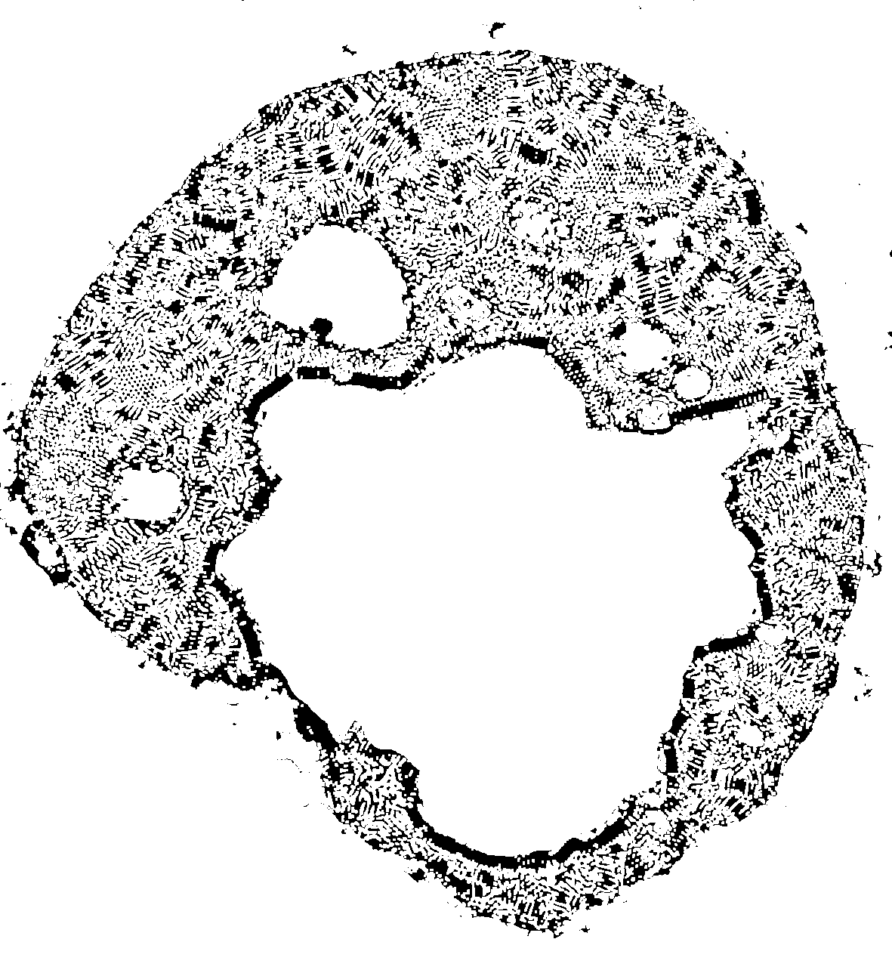
Disk kernel radius 1

Slide 91
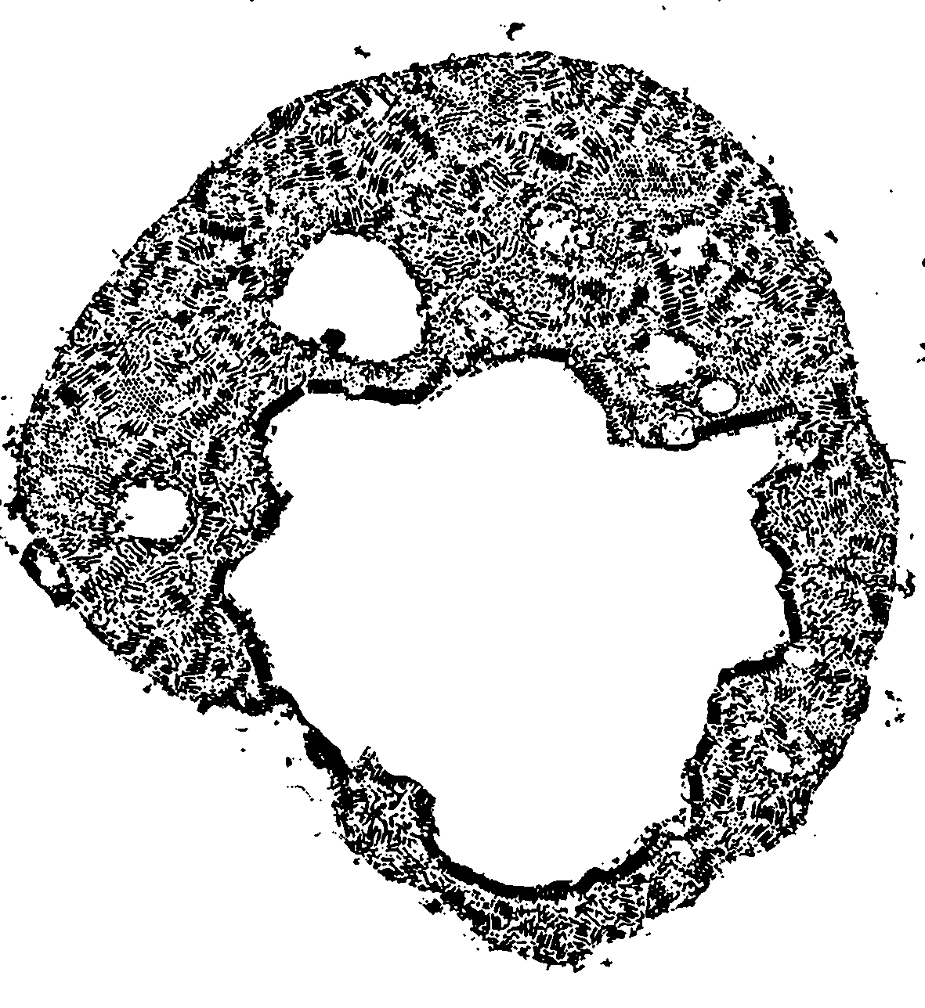

Slide 92
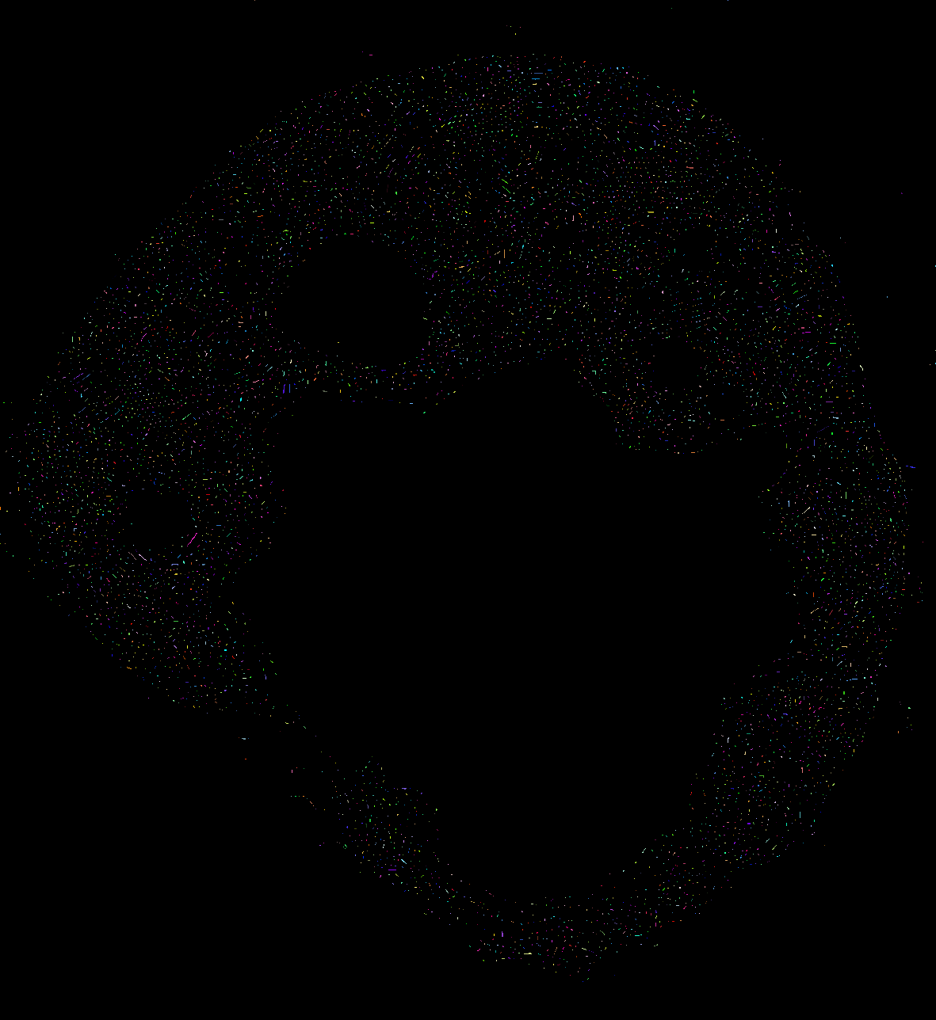
We count 6978
Actual: Who know!!!

Slide 93
